Slide 1



Slide 2

Intro
A Modern Solution to Outdated Comparison Tools
Access to multiple retailers & sellers of tyres all on 1 website
Compare All of their information, without needing to create accounts on all the websites
Honest and up to date pricing; no need to worry about fake sale
Dedicated tire search & filter tools To find tyres that fit your car’s model, year, and needs
As a seller you can get real time analytics on what your clients are looking for most to prepare your own stock
We care for your privacy

Slide 3
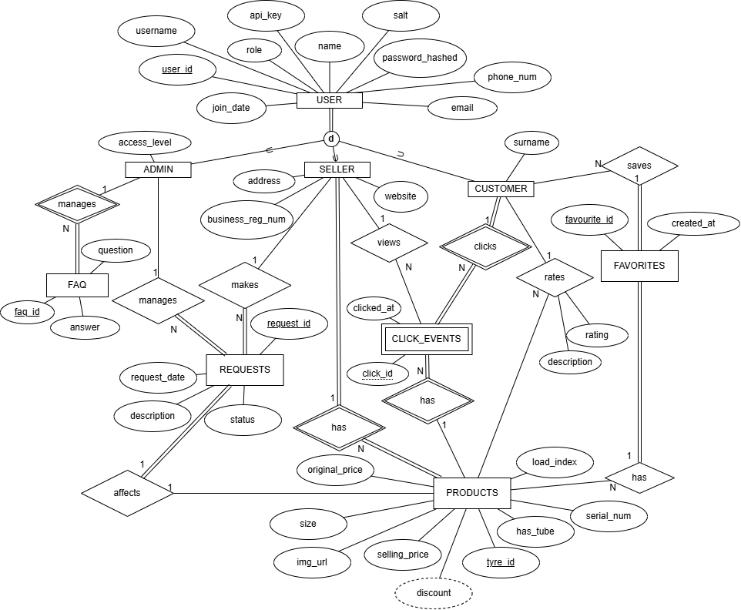
Task 2: Our ER Diagram

Slide 4
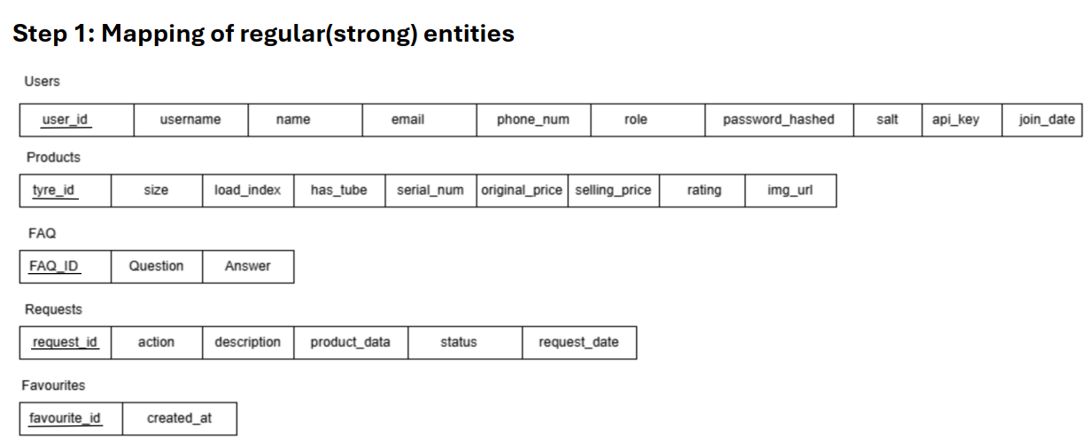

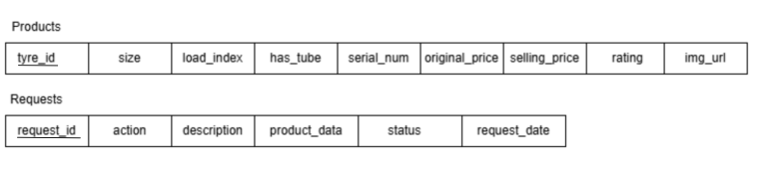
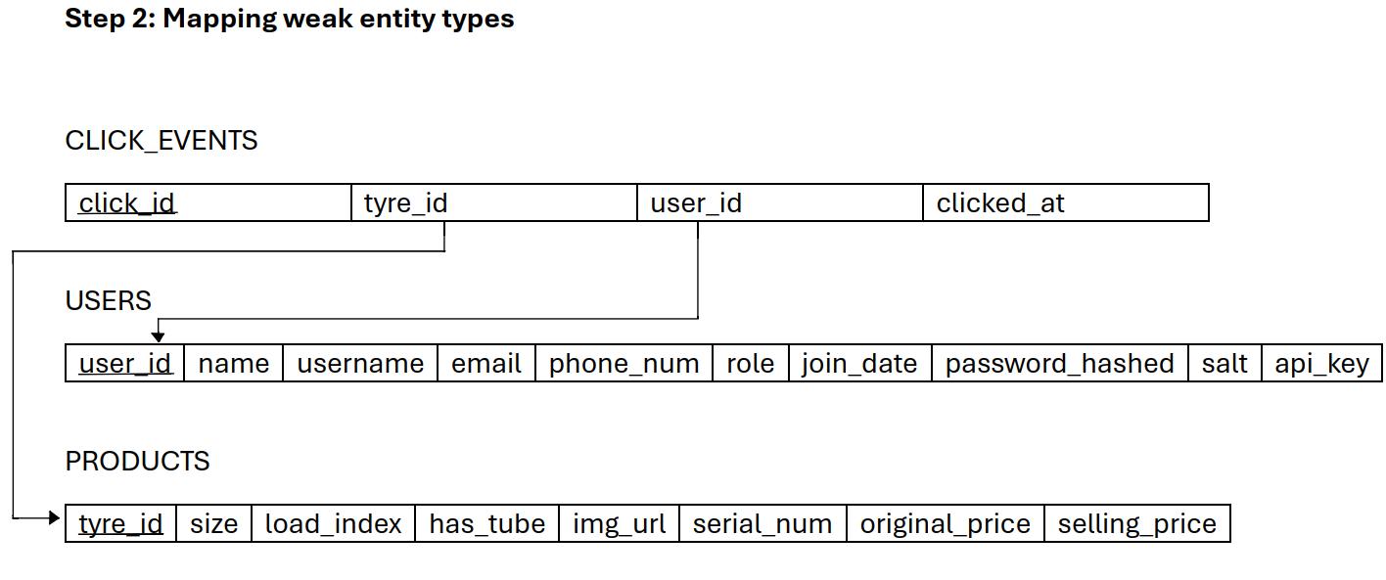
Our Relation Mapping – (Step 1-3)

Slide 5
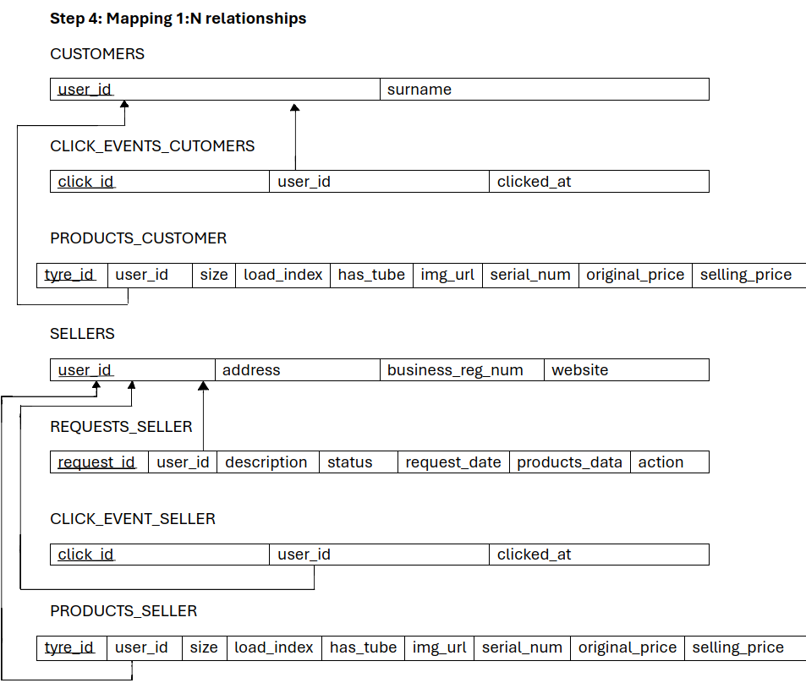
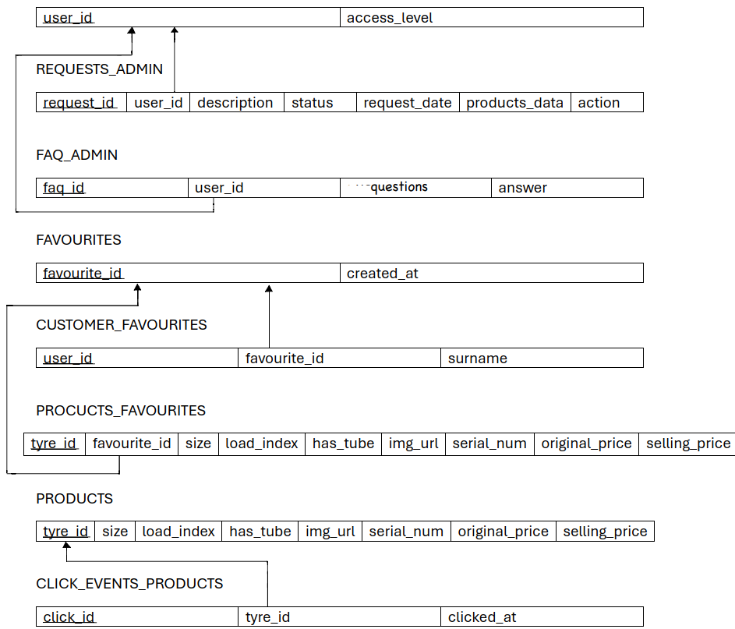
Our Relation Mapping – (Step 4)

Slide 6
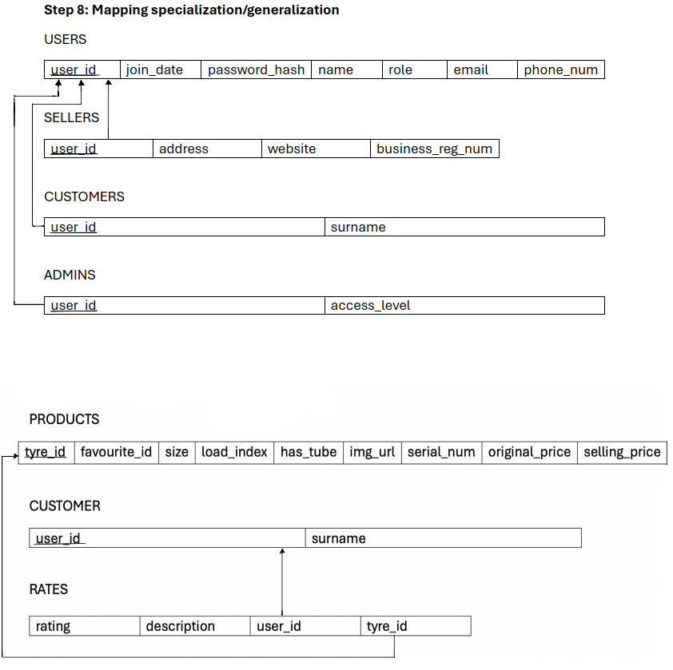
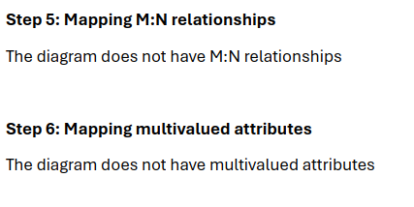


Our Relation Mapping – (Step 5 – 9)

Slide 7
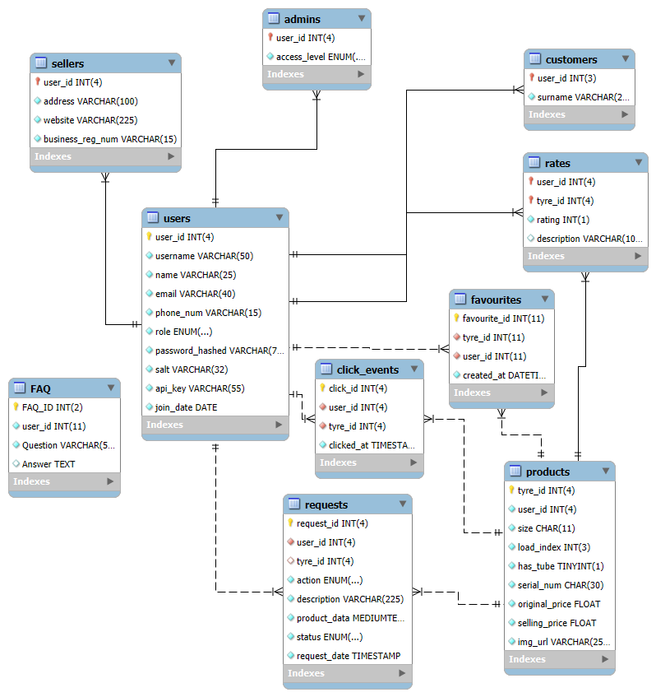
Task 4: Our Relation Schema

Slide 8
Task 6: Data
To populate our data, we used a data set from Kaggle and downloaded a csv file:
We done this because:
The dataset contained 2000+ tyre listings
The dataset was sourced from reputable retailers or APIs, so it was credible
The data had been sourced from real-world brands and actual data
We could remove duplicates to ensure data integrity
Separating tyres by brand made it easier to associate products with their users, because we had multiple sellers
We could ensure that the database was normalised by properly linking users to products via foreign keys

Slide 9
Task 7: Analyse and optimise

Slide 10
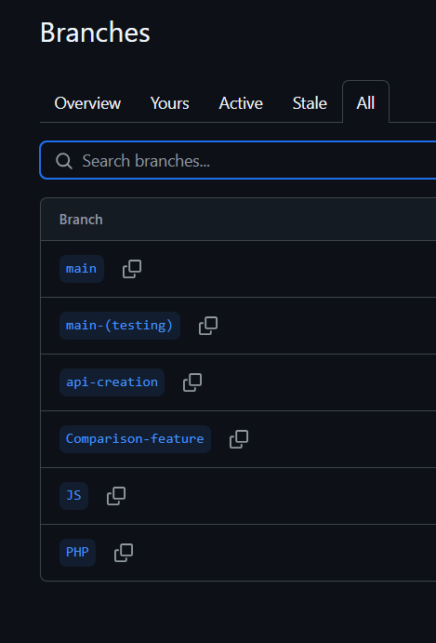
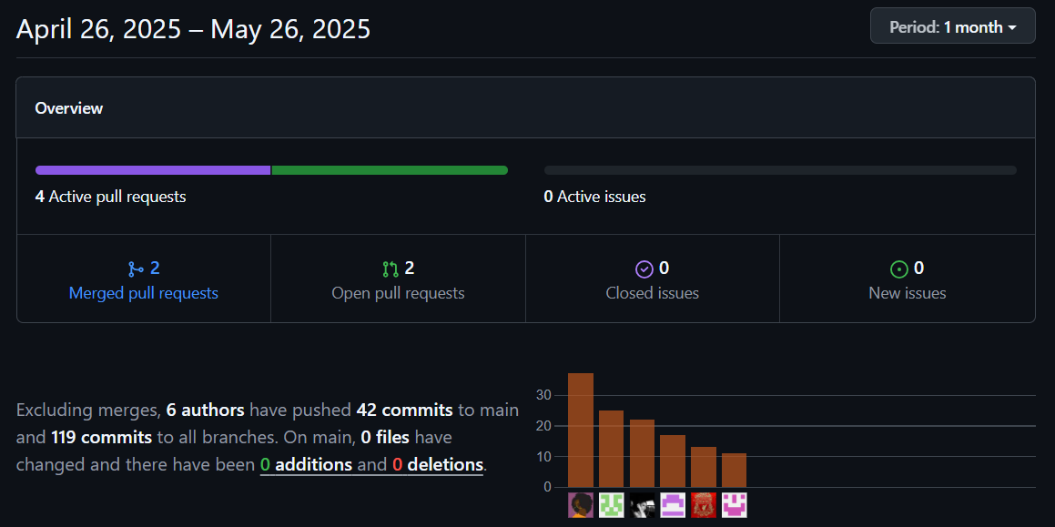
Github

